Slide 1

Introduction to CSS

Slide 2
Agenda
What is CSS?
CSS Syntax
CSS Selector
How to CSS
CSS Functions
CSS Units
CSS References
HTML Style

Slide 3
What is CSS?
CSS is the language we use to style a web page
CSS stands for Cascading Style Sheets
CSS describes how HTML elements are to be displayed on screen or media
CSS can control the layout of web page

Slide 4
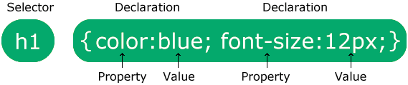
CSS Syntax
A CSS rule consists of a selector and a declaration block

Slide 5
CSS Selector
CSS selectors are to find or select the HTML elements to style
CSS can divide to 5 categories
Simple selectors
select elements based on name, id, class
Combinator selectors
select elements based on a specific relationship between them
Pseudo-class selectors
select elements based on a certain state
Pseudo-elements selectors
select and style a part of an element
Attribute selector
select elements based on an attribute or attribute value

Slide 6
CSS Selector
Simple Selector
Selector | Example | Example description
#id | #firstname | Selects the element with id="firstname"
.class | .intro | Selects all elements with class="intro"
element.class | p.intro | Selects only <p> elements with class="intro"
* | * | Selects all elements
element | p | Selects all <p> elements
element,element,.. | div, p | Selects all <div> elements and all <p> elements

Slide 7
CSS Selector
#id Selector
syntax
example
#id { css declarations; }
#firstname { background-color: yellow; }

Slide 8
CSS Selector
.class Selector
syntax
example
.class { css declarations; }
.intro { background-color: yellow; }

Slide 9
CSS Selector
element.class Selector
syntax
example
element.class { css declarations; }
p.intro { background-color: yellow; }

Slide 10
CSS Selector
* Selector
syntax
example
* { css declarations; }
div * { background-color: yellow; }

Slide 11
CSS Selector
element Selector
syntax
example
element { css declarations; }
p { background-color: yellow; }

Slide 12
CSS Selector
element,element Selector
syntax
example
element, element { css declarations; }
h2, p { background-color: yellow; }

Slide 13
How to CSS
Using CSS in 3 ways
Inline
by using the style attribute inside HTML elements
Internal
by using a <style> element in the <head> section
External
by using a <link> element to link to an external CSS file

Slide 14
How to CSS
Inline CSS
<!DOCTYPE html>
<html>
<body style="background-color: powderblue;">
<h1 style="color: blue;">A Blue Heading</h1>
<p style="color: red;">A red paragraph.</p>
</body>
</html>

Slide 15
How to CSS
Internal CSS
<!DOCTYPE html>
<html>
<head>
<style>
body { background-color: powderblue;}
h1 {color: blue;}
p {color: red;}
</style>
</head>
<body>
<h1>A Blue Heading</h1>
<p>A red paragraph.</p>
</body>
</html>

Slide 16
How to CSS
External CSS
style.css
<!DOCTYPE html>
<html>
<head>
<link rel="stylesheet" href="style.css">
</head>
<body>
<h1>A Blue Heading</h1>
<p>A red paragraph.</p>
</body>
</html>
body { background-color: powderblue;}
h1 {color: blue;}
p {color: red;}

Slide 17
How to CSS
Cascading Priority
1. inline style (inside an HTML element)
2. external and internal style (in the head section)
3. browser default
inline style has the highest priority,
and will override external and internal styles
and browser defaults

Slide 18
CSS Functions
CSS functions are used as a value for various CSS properties
Function | Description
attr() | Returns the value of an attribute of the selected element
calc() | Allows you to perform calculations to determine CSS property values
conic-gradient() | Creates a conic gradient
counter() | Returns the current value of the named counter
cubic-bezier() | Defines a Cubic Bezier curve
hsl() | Defines colors using the Hue-Saturation-Lightness model (HSL)
hsla() | Defines colors using the Hue-Saturation-Lightness-Alpha model (HSLA)
linear-gradient() | Creates a linear gradient

Slide 19
CSS Functions
Function | Description
max() | Uses the largest value, from a comma-separated list of values, as the property value
min() | Uses the smallest value, from a comma-separated list of values, as the property value
radial-gradient() | Creates a radial gradient
repeating-conic-gradient() | Repeats a conic gradient
repeating-linear-gradient() | Repeats a linear gradient
repeating-radial-gradient() | Repeats a radial gradient
rgb() | Defines colors using the Red-Green-Blue model (RGB)
rgba() | Defines colors using the Red-Green-Blue-Alpha model (RGBA)
var() | Inserts the value of a custom property

Slide 20
CSS Units
Absolute Length
The absolute length units are fixed and a length expressed in any of these will appear as exactly that size
Unit | Description
cm | centimeters
mm | millimeters
in | inches (1in = 96px = 2.54cm)
px * | pixels (1px = 1/96th of 1in)
pt | points (1pt = 1/72 of 1in)
pc | picas (1pc = 12 pt)

Slide 21
CSS Units
Relative Length
Relative length units specify a length relative to another length property
Unit | Description
em | Relative to the font-size of the element (2em means 2 times the size of the current font)
ex | Relative to the x-height of the current font (rarely used)
ch | Relative to the width of the "0" (zero)
rem | Relative to font-size of the root element
vw | Relative to 1% of the width of the viewport*
vh | Relative to 1% of the height of the viewport*
vmin | Relative to 1% of viewport's* smaller dimension
vmax | Relative to 1% of viewport's* larger dimension
% | Relative to the parent element
Notes:
(16px=1em).

Slide 22
CSS Reference
initial
used to set a property to its default value
inherit
used to set a property to its value from its parent
unset
used to resets a property of an element (inherit + initial)
revert
used to reset a property back to the browser specific style
revert-layer
used to reset a property back to a previous layer
all
shorthand property of an element’s properties (all properties)
Notes:
initial: The default value for the property (the browser default).
inherit: Get the property from the parent element.
unset: Acts as either inherit or initial. It’ll act as inherit if the parent has a value that matches, or else it will act as initial

Slide 23
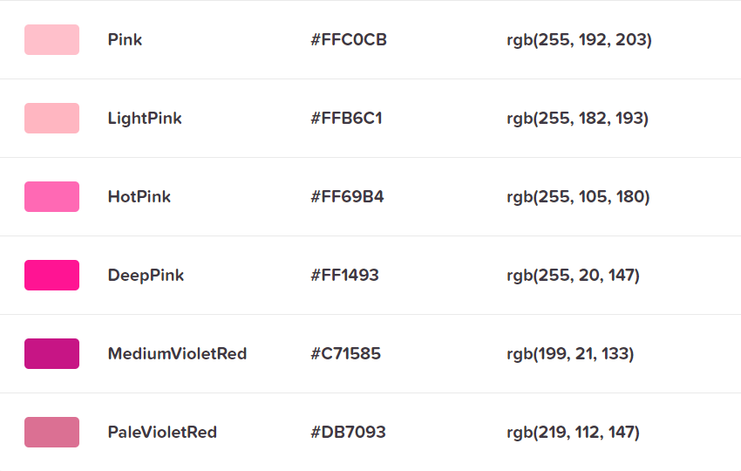
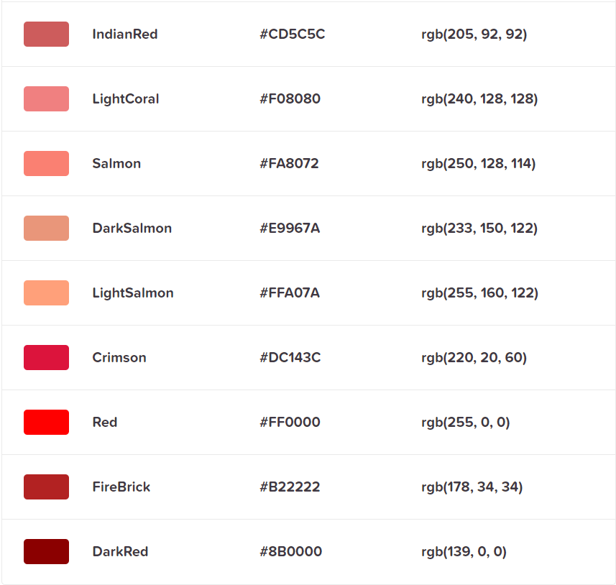
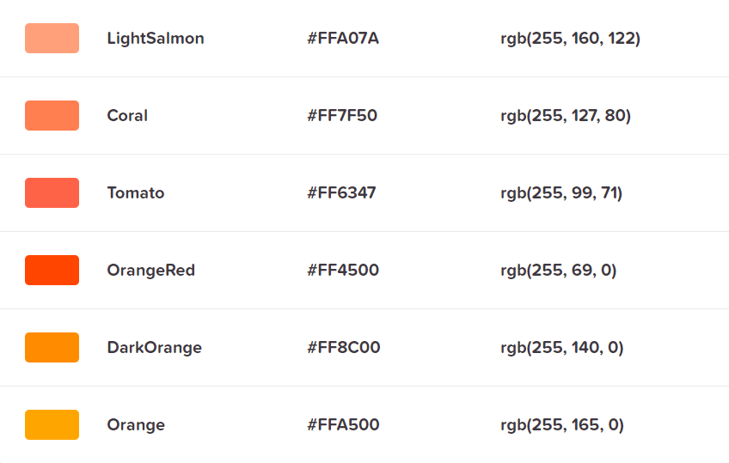
CSS Color
Color Name

Slide 24
CSS Color
Back Ground Color
<!DOCTYPE html>
<html>
<body>
<h1 style="background-color: blue;">A Blue Heading</h1>
<p style="background-color: red;">A red paragraph.</p>
</body>
</html>

Slide 25
CSS Color
Text Color
<!DOCTYPE html>
<html>
<body>
<h1 style="color: blue;">A Blue Heading</h1>
<p style="color: red;">A red paragraph.</p>
</body>
</html>

Slide 26
CSS Color
Border Color
<!DOCTYPE html>
<html>
<body>
<h1 style="border: 2px solid blue;">A Blue Heading</h1>
<p style="border: 2px solid red;">A red paragraph.</p>
</body>
</html>

Slide 27
CSS Color
Color Value
HEX - #rrggbb, #rgb
RGB – rgb(red, green, blue)
RGBA – rgba(red, green, blue, alpha)
HSL – hsl(hue, saturation, lightness)
HSLA – hsla(hue, saturation, lightness, alpha)
Hue is a degree on the color wheel from 0 to 360. 0 is red, 120 is green, and 240 is blue
Saturation is a percentage value. 0% means a shade of gray, and 100% is the full color
Lightness is also a percentage value. 0% is black, and 100% is white
Alpha parameter is a number between 0.0 (fully transparent) and 1.0 (not transparent)

Slide 28
CSS Color
Color Value
<!DOCTYPE html>
<html>
<body>
<h1 style="color: #FF0000;">A red Heading</h1>
<h1 style="color: #00F;">A blue Heading</h1>
<h1 style="color: rgb(255,0,0);">A red Heading.</h1>
<h1 style="color: hsl(240,100%,50%)">A blue Heading</h1>
<h1 style="color: rgba(255,0,0,1.0);">A red Heading.</h1>
<h1 style="color: hsla(240,100%,50%,1.0)">A blue Heading</h1>
</body>
</html>

Slide 29
CSS Background
background-color
opacity - specifies the opacity/transparency a value from 0.0 - 1.0
<!DOCTYPE html>
<html>
<body>
<h1 style="background-color: #FF0000;">A red Heading</h1>
<h1 style="background-color: #0000FF; opacity: 0.5;">A blue Heading</h1>
</body>
</html>

Slide 30
CSS Background
background-image
<!DOCTYPE html>
<html>
<head>
<style>
div {
width: 100%; height: 100%;
background-image: url('building.jpg');
}
</style>
</head>
<body>
<div></div>
</body>
</html>
Notes:
specifies an image to use as the background of an element.
By default, the image is repeated so it covers the entire element

Slide 31
CSS Background
background-image
background-repeat
repeat-x, repeat-y, no-repeat
background-position
top, right, bottom, left, center
percentage ex. 25% 75% (x% y%)
length values ex. 5cm 5cm (xpos ypos)
edge offsets values ex. left 25% top 75%
background-attachment
fixed, scroll
background-size
auto, cover, contain, or width height
background shorthand
background-color > background-image > background-repeat > background-attachment > background-position
Notes:
cover - resize the background image to cover the entire container, even if it has to stretch the image or cut a little bit off one of the edges
contain - resize the background image to make sure the image is fully visible

Slide 32
CSS Background
background-repeat
<!DOCTYPE html>
<html>
<head>
<style>
div {
width: 100%; height: 100%;
background-image: url('building.jpg');
background-repeat: no-repeat;
background-size: cover;
}
</style>
</head>
<body>
<div></div>
</body>
</html>

Slide 33
CSS Background
background-position
<!DOCTYPE html>
<html>
<head>
<style>
div {
width: 100%; height: 100%;
background-image: url('go.png');
background-repeat: no-repeat;
background-position: top right;
}
</style>
</head>
<body>
<div></div>
</body>
</html>

Slide 34
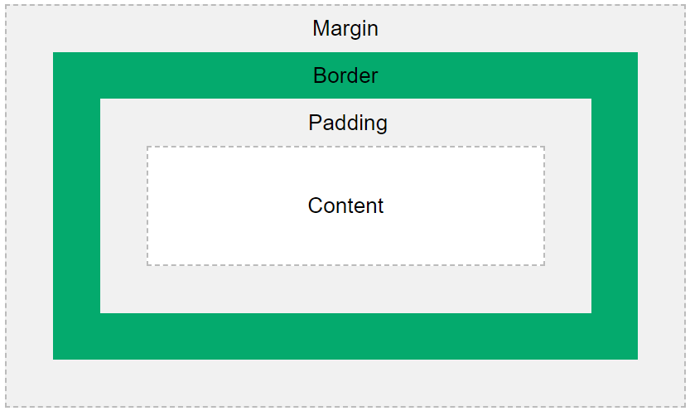
CSS Box Model
All HTML elements can be considered as boxes
Notes:
Content - The content of the box, where text and images appear
Padding - Clears an area around the content. The padding is transparent
Border - A border that goes around the padding and content
Margin - Clears an area outside the border. The margin is transparent

Slide 35
CSS Border
To specify the style, width and color of an element’s border
border-width
border-style
dotted, dashed, solid, double, groove, ridge, inset, outset, none, hidden
border-color
border-radius
border side
border-top, border-right, border-bottom, border-left
border shorthand
border-width > border-style > border-color

Slide 36
CSS Border
<!DOCTYPE html>
<html>
<body>
<p style="border-width: 2px; border-style: dotted; border-color: red;">Border dotted</p>
<p style="border: 2px dashed green;">Border dashed</p>
<p style="border: 2px solid blue;">Border solid</p>
<p style="border: 2px double black;">Border double</p>
<p style="border: 2px groove black;">Border groove</p>
<p style="border: 2px ridge black;">Border ridge</p>
<p style="border: 2px inset black;">Border inset</p>
<p style="border: 2px outset black;">Border outset</p>
<p style="border: 2px none black;">Border none</p>
<p style="border: 2px hidden black;">Border hidden</p>
<p style="border-bottom: 2px solid black;">Border side</p>
<p style="border: 2px solid black; border-radius: 10px;">Border radius</p>
</body>
</html>

Slide 37
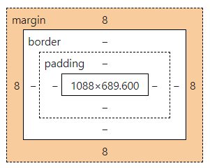
CSS Margin
Margins are used to create space around elements outside of any defined borders
margin side
margin-top, margin-right, margin-bottom, margin-left
values: auto, length, %
margin shorthand
top > right > bottom > left

Slide 38
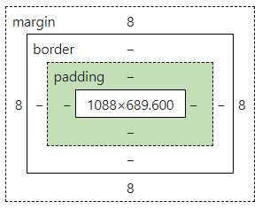
CSS Padding
Padding is used to create space around an element’s content inside of any defined borders
padding side
padding-top, padding-right, padding-bottom, padding-left
values: length, %
padding shorthand
top > right > bottom > left

Slide 39
CSS Width/Height
Setting width/height
width
height
max-width, min-width
max-height, min-height
Setting width/height values
auto – browser calculate width and height
length – defined in units, ex. cm, px, pt
% - defined in percent of containing block

Slide 40
CSS Outline
An outline is a line drawn outside the element’s border
outline-width
outline-style
dotted, dashed, solid, double, groove, ridge, inset, outset, none, hidden
outline-color
outline-offset
outline shorthand
outline-width > outline-style > outline-color

Slide 41
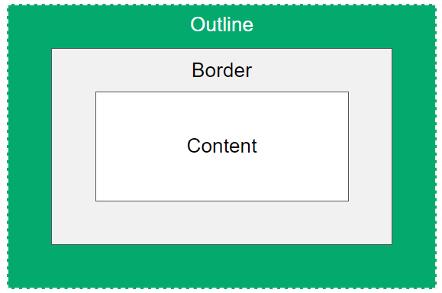
CSS Outline
Outline is NOT a part of the element’s dimension that may overlap other content

Slide 42
CSS Text
A lot of properties for formatting text
color
text-align
center, left, right, justify
text-align-last
text-decoration-line
overline, underline, line-through
text-decoration-color
text-decoration-style
dotted, dashed, solid, double, wavy
text-decoration-thickness
text-decoration shorthand
text-decoration-line > text-decoration-color > text-decoration-style > text-decoration-thickness
Notes:
"justify" each line is stretched so that every line has equal width, and the left and right margins are straight (like in magazines and newspapers)
text-align-last property specifies how to align the last line of a text

Slide 43
CSS Text
A lot of properties for formatting text
text-transformation
uppercase, lowercase, capitalize, none
text-indent
letter-spacing
line-height
word-spacing
white-space
normal, nowrap, pre, pre-wrap, pre-line, break-spaces
text-shadow
offset-x > offset-y > blur-radius > color
text-overflow
clip, ellipsis
Notes:
text-indent property is used to specify the indentation of the first line of a text
letter-spacing property is used to specify the space between the characters in a text
line-height property is used to specify the space between lines
word-spacing property is used to specify the space between the words in a text

Slide 44
CSS Text
<!DOCTYPE html>
<html>
<head>
<style>
div { width: 200px; }
.txt-left { text-align: left; color: red; }
.txt-center { text-align: center; color: green; text-transform: capitalize; }
.txt-right { text-align: right; color: blue; text-transform: uppercase; }
.txt-line { text-decoration: underline black dotted; }
.txt-shadow { text-shadow: 1px 1px blue; }
.txt-space { white-space: nowrap; }
.txt-over { overflow: hidden; text-overflow: ellipsis; }
</style>
</head>
<body>
<div>
<div class="txt-left txt-line">text left under line</div>
<div class="txt-center txt-decorate">text center</div>
<div class="txt-right">text right</div>
<div class="txt-shadow">text shadow</div>
<div class="txt-space">This is simple text if it exceed width limit.</div>
<div class="txt-space txt-over">This is simple text if it exceed width limit.</div>
</div>
</body>
</html>

Slide 45
CSS Font
Generic Font Families
Serif – fonts have a small stroke at the edges of each letter
Sans-serif – fonts have clean lines no small strokes attached
Monospace – fonts all the letters have the same fixed width
Cursive – fonts imitate human handwriting
Fantasy – fonts are decorative and playful

Slide 46
CSS Font
Font Example
Font Family | Examples of Font
Serif | Times New Roman Georgia Garamond
Sans-serif | Arial Verdana Helvetica
Monospace | Courier New Lucida Console Monaco
Cursive | Brush Script MT Lucida Handwriting
Fantasy | Copperplate Papyrus

Slide 47
CSS Font
Properties
font-family
font-size
font-style
normal, italic, oblique
font-weight
normal, bold, lighter, <number: 1 - 1000>
font-variant
normal, small-caps
font shorthand
font-style > font-variant > font-weight > font-size > font-family

Slide 48
CSS Font
<!DOCTYPE html>
<html>
<head>
<link rel="preconnect" href="https://fonts.googleapis.com">
<link rel="preconnect" href="https://fonts.gstatic.com" crossorigin>
<link href="https://fonts.googleapis.com/css2?family=Pacifico&display=swap" rel="stylesheet">
<style>
.fnt-family { font-family: 'Courier New', Courier, monospace; }
.fnt-size { font-family: 'Times New Roman', Times, serif; font-size: 2em; }
.fnt-style { font-style: italic; }
.fnt-weight { font-weight: bold; }
.fnt-hand { font: 20px Arial, Helvetica, sans-serif; }
.fnt-api { font-family: 'Pacifico', cursive; }
</style>
</head>
<body>
<div>
<div class="fnt-family">Font Family</div>
<div class="fnt-size">Font Size</div>
<div class="fnt-style">Font Style</div>
<div class="fnt-weight">Font Weight</div>
<div class="fnt-hand">This is a simple font</div>
<div class="fnt-api">This is a simple font api</div>
</div>
</body>
</html>
Notes:
https://fonts.google.com/

Slide 49
CSS Icon
Icon font - I
<!DOCTYPE html>
<html>
<head>
<link rel="stylesheet" href="https://cdnjs.cloudflare.com/ajax/libs/font-awesome/4.7.0/css/font-awesome.min.css">
</head>
<body>
<div>
Basic icons<br/>
<em class="fa fa-car"></em>
<em class="fa fa-car" style="font-size:48px;"></em>
<em class="fa fa-car" style="font-size:60px;color:red;"></em>
<br/><br/>Animate icon<br/>
<em class="fa fa-spinner fa-spin"></em>
<em class="fa fa-circle-o-notch fa-spin"></em>
<em class="fa fa-refresh fa-spin"></em>
<em class="fa fa-cog fa-spin"></em>
<br/><br/>Rotate icons<br/>
<em class="fa fa-car fa-rotate-90"></em>
<em class="fa fa-car fa-rotate-180"></em>
<em class="fa fa-car fa-flip-horizontal"></em>
<em class="fa fa-car fa-flip-vertical"></em>

Slide 50
CSS Icon
Icon font - II
<br/><br/>Stack icons<br/>
<span class="fa-stack fa-lg">
<em class="fa fa-circle-thin fa-stack-2x"></em>
<em class="fa fa-twitter fa-stack-1x"></em>
</span>
<span class="fa-stack fa-lg">
<em class="fa fa-circle fa-stack-2x"></em>
<em class="fa fa-twitter fa-stack-1x fa-inverse"></em>
</span>
<span class="fa-stack fa-lg">
<em class="fa fa-camera fa-stack-1x"></em>
<em class="fa fa-ban fa-stack-2x text-danger" style="color:red;"></em>
</span>
</div>
</body>
</html>

Slide 51
CSS Display
The display property specified if/how an element is displayed
block – a block element always starts on a new line and take up the full width
inline – an inline element does not start on a new line and only takes up as much width as necessary
inline-block - allows to set a width and height on the element, margin/padding are respected
none – to hide and show element without deleting and recreating

Slide 52
CSS Position
The position property specified the type of positioning method used for an element
static - default. elements are not affected by the top, bottom, left and right properties. It is always positioned according to the normal flow of the page
relative – an element is positioned relative to its normal position. Setting the top, bottom, left and right properties will cause it to be adjusted away from its normal position
fixed – an element is positioned relative to the viewport it always stays in the same place event if the page is scrolled
absolute – an element is positioned relative to the nearest positioned ancestor (like fixed)
sticky – an element is positioned base on the user’s scroll position
Notes:
HTML elements are positioned static by default

Slide 53
CSS Z-Index
The z-index property specified the stack order of an element which element should be placed in front of or behind the others

Slide 54
CSS Overflow
The overflow property specified whether to clip the content or to add scrollbars when the content of an element is too big to fit in the specified area
visible – default. the overflow is not clipped, the content renders outside the element’s box
hidden – the overflow is clipped and the rest of the content will be invisible
scroll – the overflow is clipped and a scrollbar is added to seed the rest of the content
auto – like scroll but it adds scrollbars only when necessary
overflow-x – specified what to do with the left/right edges of the content
overflow-y – specified what to do with the top/bottom edges of the content

Slide 55
CSS Float
The float property is used for positioning and formatting content
left – the element floats to the left of its container
right – the element floats to the right of its container
none – the element does not float. default.

Slide 56
CSS Combinator
A CSS combinator can contain more than one simple selector
descendant selector (space)
child selector (>)
adjacent sibling selector (+)
general sibling selector (~)

Slide 57
CSS Combinator
<!DOCTYPE html>
<html>
<head>
<style>
div.vehicle p { background-color: cornsilk; }
div.book > span { background-color: yellow; }
div.drink + div { background-color: orange; }
div.food ~ label { background-color: khaki; }
</style>
</head>
<body>
<div class="vehicle">
<p>Car</p> <p>Motorcycle</p> <p>Bicycle</p>
</div> <div class="book">
<span>Java</span> <span>C++</span> <span>CS</span>
</div> <div class="drink">Drink</div>
<div>Coffee</div>
<div>Tea</div>
<div>Coca Cola</div> <div class="food">Food</div>
<label>Salad</label>
<label>Steak</label>
<label>Spaghetti</label> </body>
</html>

Slide 58
CSS Pseudo
Pseudo class
Selector | Example | Example description
:active | a:active | Selects the active link
:checked | input:checked | Selects every checked <input> element
:disabled | input:disabled | Selects every disabled <input> element
:empty | p:empty | Selects every <p> element that has no children
:enabled | input:enabled | Selects every enabled <input> element
:first-child | p:first-child | Selects every <p> elements that is the first child of its parent
:first-of-type | p:first-of-type | Selects every <p> element that is the first <p> element of its parent
:focus | input:focus | Selects the <input> element that has focus
:hover | a:hover | Selects links on mouse over
:in-range | input:in-range | Selects <input> elements with a value within a specified range

Slide 59
CSS Pseudo
Pseudo class
Selector | Example | Example description
:invalid | input:invalid | Selects all <input> elements with an invalid value
:lang(language) | p:lang(it) | Selects every <p> element with a lang attribute value starting with "it"
:last-child | p:last-child | Selects every <p> elements that is the last child of its parent
:last-of-type | p:last-of-type | Selects every <p> element that is the last <p> element of its parent
:link | a:link | Selects all unvisited links
:not(selector) | :not(p) | Selects every element that is not a <p> element
:nth-child(n) | p:nth-child(2) | Selects every <p> element that is the second child of its parent

Slide 60
CSS Pseudo
Pseudo class
Selector | Example | Example description
:nth-last-child(n) | p:nth-last-child(2) | Selects every <p> element that is the second child of its parent, counting from the last child
:nth-last-of-type(n) | p:nth-last-of-type(2) | Selects every <p> element that is the second <p> element of its parent, counting from the last child
:nth-of-type(n) | p:nth-of-type(2) | Selects every <p> element that is the second <p> element of its parent
:only-of-type | p:only-of-type | Selects every <p> element that is the only <p> element of its parent
:only-child | p:only-child | Selects every <p> element that is the only child of its parent
:optional | input:optional | Selects <input> elements with no "required" attribute

Slide 61
CSS Pseudo
Pseudo class
Selector | Example | Example description
:out-of-range | input:out-of-range | Selects <input> elements with a value outside a specified range
:read-only | input:read-only | Selects <input> elements with a "readonly" attribute specified
:read-write | input:read-write | Selects <input> elements with no "readonly" attribute
:required | input:required | Selects <input> elements with a "required" attribute specified
:root | root | Selects the document's root element
:target | #news:target | Selects the current active #news element (clicked on a URL containing that anchor name)
:valid | input:valid | Selects all <input> elements with a valid value
:visited | a:visited | Selects all visited links

Slide 62
CSS Pseudo
Pseudo element
Selector | Example | Example description
::after | p::after | Insert content after every <p> element
::before | p::before | Insert content before every <p> element
::first-letter | p::first-letter | Selects the first letter of every <p> element
::first-line | p::first-line | Selects the first line of every <p> element
::marker | ::marker | Selects the markers of list items
::selection | p::selection | Selects the portion of an element that is selected by a user

Slide 63
CSS Attribute Selector
The attribute selector is used to select elements with a specified attribute
[attribute] – used to specified attribute
[attribute="value"] – used to specified attribute and value
[attribute~="value"] – used to select with an attribute value containing a specified word (space-separated)
[attribute|="value"] – used to select with an attribute whose value can be exactly specified value
[attribute^="value"] – used to select with an attribute whose value starts with specified value
[attribute$="value"] – used to select with an attribute whose value ends with a specified value
[attribute*="value"] – used to select with an attribute whose value contain a specified value

Slide 64
CSS Opacity/Transparency
The opacity property specified the opacity/transparency of an element
value from 0.0 – 1.0 the lower value is more transparent
<!DOCTYPE html>
<html>
<head>
<style>
img { opacity: 0.5; }
img:hover { opacity: 1.0; }
</style>
</head>
<body>
<img src="burger.png"/>
<img src="cake.png"/>
<img src="pie.png"/>
</body>
</html>

Slide 65
CSS !important
The !important rule in CSS is used to add more importance to a property/value than normal
It will override ALL previous styling rules for that specific property on element
Do not use it unless you absolutely have to

Slide 66
CSS Link
Link states
a:link – a normal, unvisited link
a:visited – a link the user has visited
a:hover – a link when user mouses over it
a:active – a link the moment it is clicked

Slide 67
CSS Link
<!DOCTYPE html>
<html>
<head>
<style>
a.a1:link { background-color: yellow; }
a.a1:visited { background-color: cyan; }
a.a1:hover { background-color: lightgreen; }
a.a1:active { background-color: hotpink; }
a.a2:link, a.a2:visited {
background-color: crimson;
color: white;
padding: 14px 25px;
text-align: center;
text-decoration: none;
display: inline-block;
}
a.a2:hover, a.a2:active { background-color: red; }
</style></head>
<body>
<a href="#0" class="a1">This is a link</a>
<a href="#0" class="a2">This is a button</a>
</body>
</html>

Slide 68
CSS List
2 type of list
Unordered list (<ul>) – the list items are marked as bullets
Ordered list (<ol>) – the list items are marked with numbers or letters
Properties
list-style-type – specified the type of list item marker
list-style-image – specified an image as the list item marker
list-style-position – inside, outside
list shorthand
list-style-type > list-style-position > list-style-image

Slide 69
CSS List
<!DOCTYPE html>
<html>
<head>
<style>
ol.vehicle { list-style-type: none; }
ul.book { list-style-position: outside; }
ul.drink { list-style: square inside url("sqpurple.gif"); }
</style>
</head>
<body>
<ol class="vehicle">
<li>Car</li>
<li>Motorcycle</li>
<li>Bicycle</li>
</ol>
<ul class="book">
<li>Java</li>
<li>C++</li>
<li>CS</li>
</ul>
<ul class="drink">
<li>Coffee</li>
<li>Tea</li>
<li>Coca Cola</li>
</ul>
</body>
</html>

Slide 70
CSS Table
Table border
ex. border: 1px solid;
Table size
ex. width: 100%; height: 100px;
Table alignment
ex. text-align: center; vertical-align: bottom;
Table hover
ex. tr:hover { background-color: coral; }
Table striped
ex. tr:nth-child(even) { background-color: coral; }
Table Color
ex. th { background-color: teal; color: white; }

Slide 71
CSS Table
Table properties
border-collapse: separate;
separate – borders are separated, each cell will display its own borders
collapse – borders are collapsed into a single border
caption-side: bottom; (top/bottom)
Specified placement of a table caption
table-layout: fixed;
auto – the column width is set by the widest unbreakable content in the cells
fixed - the column widths area divided equally access the table

Slide 72
CSS Table
<!DOCTYPE html>
<html>
<head>
<style>
table { caption-side: bottom; border-collapse: collapse; width: 250px; }
table th { background-color: teal; color: white; }
table, th, td { border: 2px solid black; }
tbody tr:nth-child(even) { background-color: linen; }
tbody tr:hover { background-color: coral; }
tbody tr td:nth-child(2) { text-align: right; }
tfoot tr td { text-align: right; background-color: lightgray; }
</style>
</head>
<body>
<table>
<caption>Book Store</caption>
<thead>
<tr><th>Book</th><th>Price</th></tr>
</thead>
<tbody>
<tr><td>Java</td><td>550</td></tr>
<tr><td>C++</td><td>450</td></tr>
<tr><td>C#</td><td>350</td></tr>
<tr><td>Python</td><td>390</td></tr>
</tbody>
<tfoot><tr><td>Total</td><td>1740</td></tr></tfoot>
</table>
</body>
</html>

Slide 73
CSS Table
Table responsive - I
<!DOCTYPE html>
<html>
<head>
<style>
table { border-collapse: separate; table-layout: fixed; border-spacing: 0; }
table th { background-color: teal; color: white; }
table, th, td { border: 1px solid black; white-space: nowrap; }
#bookpanel { overflow-x: auto; width: 395px; height: 107px;}
#booktable thead th { position: sticky; top: 0; }
.sticky-head { z-index: 1; }
.sticky-col { position: sticky; background-color: white; }
.first-col { width: 25px; min-width: 25px; max-width: 25px; left: 0px; }
.second-col { width: 80px; min-width: 80px; max-width: 80px; left: 25px; }
</style>
</head>
<body>
<div id="bookpanel">
<table id="booktable">
<thead>
<tr>
<th class="sticky-head first-col">No.</th>
<th class="sticky-head second-col">Book</th>
<th>Price</th> <th>Title</th> <th>Edition</th> <th>Author</th> <th>Publisher</th>
</tr>

Slide 74
CSS Table
Table responsive - II
</thead>
<tbody id="bookbody">
<tr><td class="sticky-col first-col">1</td><td class="sticky-col second-col">Java</td><td>550</td><td>Effective Java</td><td>5th Edition</td><td>Joshua Bloch</td><td>O'Reilly</td></tr>
<tr><td class="sticky-col first-col">2</td><td class="sticky-col second-col">C++</td><td>450</td><td>C++ Pocket Reference</td><td>1th Edition</td><td>Kyle Loudon</td><td>O'Reilly</td></tr>
<tr><td class="sticky-col first-col">3</td><td class="sticky-col second-col">C#</td><td>350</td><td>Head First C#</td><td>4th Edition</td><td>Andrew Stellman</td><td>O'Reilly</td></tr>
<tr><td class="sticky-col first-col">4</td><td class="sticky-col second-col">Python</td><td>390</td><td>Learning Python</td><td>5th Edition</td><td>Mark Lutz</td><td>O'Reilly</td></tr>
<tr><td class="sticky-col first-col">5</td><td class="sticky-col second-col">Type Script</td><td>490</td><td>TypeScript Cookbook</td><td>1th Edition</td><td>Stefan Baumgartner</td><td>O'Reilly</td></tr>
</tbody>
</table>
</div>
</body>
</html>

Slide 75
CSS Border Image
The CSS border-image property allows you to specify an image to be used as the border around an element
Property | Description
border-image | A shorthand property for setting all the border-image-* properties
border-image-source | Specifies the path to the image to be used as a border
border-image-slice | Specifies how to slice the border image. Default 100%
border-image-width | Specifies the widths of the border image. Default 1
border-image-outset | Specifies the amount by which the border image area extends beyond the border box. Default 0
border-image-repeat | Specifies whether the border image should be repeated, rounded or stretched. Default stretch.

Slide 76
CSS Border Image
<!DOCTYPE html>
<html>
<head>
<style>
p { border: 10px solid transparent; padding: 15px;}
#borderimg1 { border-image: url(border.png) 30 round; }
#borderimg2 { border-image: url(border.png) 50 round; }
#borderimg3 { border-image: url(border.png) 20% round; }
#borderimg4 { border-image: url(border.png) 30% round; }
#borderimg5 { border-image: url(border.png) 20 stretch; }
#borderimg6 { border-image: url(border.png) 30 stretch; }
#borderimg7 { border-image: url(border.png) 20 repeat; }
#borderimg8 { border-image: url(border.png) 40 repeat; }
</style>
</head>
<body>
<p id="borderimg1">border-image: url(border.png) 30 round;</p>
<p id="borderimg2">border-image: url(border.png) 50 round;</p>
<p id="borderimg3">border-image: url(border.png) 20% round;</p>
<p id="borderimg4">border-image: url(border.png) 30% round;</p>
<p id="borderimg5">border-image: url(border.png) 20 stretch;</p>
<p id="borderimg6">border-image: url(border.png) 30 stretch;</p>
<p id="borderimg7">border-image: url(border.png) 20 repeat;</p>
<p id="borderimg8">border-image: url(border.png) 40 repeat;</p>
</body>
</html>

Slide 77
CSS Shadow
The CSS you can add shadow to text and element
text-shadow
horizontal > vertical > blur-effect > color
box-shadow
horizontal > vertical > blur-effect > spread-radius > color > inset-parameter
box-reflect
none, below, above, left, right, position offset gradient

Slide 78
CSS Shadow
text-shadow
<!DOCTYPE html>
<html>
<head>
<style>
#div1 { font-size: 50px; color: orange; text-shadow: 3px 3px 5px gray; }
#div2 { font-size: 50px; color: orange;
text-shadow: 3px 3px 5px black , 0 0 25px gold, 0 0 5px darkorange; }
#div3 { font-size: 50px; color: orange;
text-shadow: -1px 0 black, 0 1px black, 1px 0 black, 0 -1px black; }
</style>
</head>
<body>
<div id="div1">Text Shadow</div><br/>
<div id="div2">Multiple Shadow</div><br/>
<div id="div3">Text Bolder</div><br/>
</body>
</html>

Slide 79
CSS Shadow
box-shadow
<!DOCTYPE html>
<html>
<head>
<style>
div.div-box { width: 200px; height: 100px; background-color: hotpink; padding: 5px;}
#div4 { box-shadow: 5px 5px 5px 2px gray;
border-style: ridge; border-width: 10px; border-color: hotpink; }
#div5 { box-shadow: 5px 5px 5px gray; }
#div6 { box-shadow: 5px 5px 5px lightgray inset; }
#div7 { box-shadow: 0px 10px 5px -5px gray; }
#div8 { box-shadow: 5px -5px 5px gray; }
#boxtable { width: 400px; border-spacing: 5px 7px; }
#boxtable td { height: 30px;
background-color: hotpink; box-shadow: 5px 5px 5px gray; }
</style>
</head>
<body>
<div id="div4" class="div-box">Box Shadow with Border</div><br/>
<div id="div5" class="div-box">Box Shadow</div><br/>
<div id="div6" class="div-box">Box Shadow Inset</div><br/>
<div id="div7" class="div-box">Box Shadow Bottom</div><br/>
<div id="div8" class="div-box">Box Shadow Top Right</div><br/>
<table id="boxtable">
<tr><td></td><td></td></tr>
<tr><td></td><td></td></tr>
</table>
</body>
</html>

Slide 80
CSS Shadow
box-reflect
<!DOCTYPE html>
<html>
<head>
<style>
#flower { -webkit-box-reflect: below; }
#leaves { -webkit-box-reflect: below 10px linear-gradient(to bottom, rgba(0,0,0,0.00), rgba(0,0,0,0.5)); }
</style>
</head>
<body>
<img id="flower" src="flower.png" alt="flower"/>
<img id="leaves" src="leaves.png" alt="leaves"/>
</body>
</html>

Slide 81
CSS Gradient
The CSS gradient let you display smooth transitions between two or more colors
3 types of gradient
linear gradient – goes down/up/left/right/diagonally
radial gradient – defined by their center
conic gradient – rotated around a center

Slide 82
CSS Gradient
Syntax
linear-gradient
background-image: linear-gradient (direction/angle, color-stop1, color-stop2, ...);
direction top to bottom as default
radial-gradient
background-image: radial-gradient(shape size at position, start-color, ..., last-color);
shape : circle or ellipse
size : closest-side, farthest-side, closest-corner, farthest-corner
by default shape is ellipse, size is farthest-corner and position is center
conic-gradient
background-image: conic-gradient([from angle] [at position,] color [degree], color [degree], ...);
by default angle is 0deg and position is center

Slide 83
CSS Gradient
Functions
Function | Description
conic-gradient() | Creates a conic gradient. Define at least two colors (around a center point)
linear-gradient() | Creates a linear gradient. Define at least two colors (top to bottom)
radial-gradient() | Creates a radial gradient. Define at least two colors (center to edges)
repeating-conic-gradient() | Repeats a conic gradient
repeating-linear-gradient() | Repeats a linear gradient
repeating-radial-gradient() | Repeats a radial gradient

Slide 84
CSS Gradient
linear-gradient
<!DOCTYPE html>
<html>
<head>
<style>
div.div-box { width: 200px; height: 100px; }
#div1 { background-image: linear-gradient(deeppink, white); }
#div2 { background-image: linear-gradient(to right, deeppink, white); }
#div3 { background-image: linear-gradient(to bottom right, deeppink, white); }
#div4 { background-image: linear-gradient(180deg, deeppink, white); }
#div5 { background-image: linear-gradient(to right, rgba(255,20,147,1), rgba(255,0,0,0)); }
#div6 { background-image: repeating-linear-gradient(deeppink 10%, hotpink 20%, white 30%); }
</style>
</head>
<body>
<div id="div1" class="div-box">Linear by default top to bottom</div><br/>
<div id="div2" class="div-box">Linear left to right</div><br/>
<div id="div3" class="div-box">Linear diagonal top left to bottom right</div><br/>
<div id="div4" class="div-box">Linear angle 180 degree</div><br/>
<div id="div5" class="div-box">Linear using transparency</div><br/>
<div id="div6" class="div-box">Linear repeating</div><br/>
</body>
</html>

Slide 85
CSS Gradient
radial-gradient
<!DOCTYPE html>
<html>
<head>
<style>
div.div-box { width: 200px; height: 100px; }
#div1 { background-image: radial-gradient(deeppink, hotpink, white); }
#div2 { background-image: radial-gradient(deeppink 10%, hotpink 20%, white 30%); }
#div3 { background-image: radial-gradient(circle, deeppink, hotpink, white); }
#div4 { background-image: radial-gradient(closest-side at 60% 50%, deeppink, hotpink, white); }
#div5 { background-image: repeating-radial-gradient(deeppink 10%, hotpink 20%, white 30%); }
</style>
</head>
<body>
<div id="div1" class="div-box">Radial by default</div><br/>
<div id="div2" class="div-box">Radial with space</div><br/>
<div id="div3" class="div-box">Radial with circle shape</div><br/>
<div id="div4" class="div-box">Radial with closest side</div><br/>
<div id="div5" class="div-box">Radial repeating</div><br/>
</body>
</html>

Slide 86
CSS Gradient
conic-gradient
<!DOCTYPE html>
<html>
<head>
<style>
div.div-box { width: 200px; height: 100px; border-radius: 50%;}
#div1 { background-image: conic-gradient(violet, deeppink, hotpink, white); }
#div2 { background-image: conic-gradient(violet 0deg, violet 90deg, deeppink 90deg, deeppink 180deg, crimson 180deg, crimson 270deg, orange 270deg); }
#div3 { background-image: conic-gradient(from 90deg, violet, deeppink, hotpink, white); }
#div4 { background-image: conic-gradient(at 60% 40%, violet, deeppink, hotpink, white); }
#div5 { background-image: repeating-conic-gradient(deeppink 10%, white 20%); }
</style>
</head>
<body>
<div id="div1" class="div-box">Conic by default</div><br/>
<div id="div2" class="div-box">Conic with degree</div><br/>
<div id="div3" class="div-box">Conic start with angle</div><br/>
<div id="div4" class="div-box">Conic start with position</div><br/>
<div id="div5" class="div-box">Conic repeating</div><br/>
</body>
</html>

Slide 87
CSS Transform
The CSS transform allow you to move, scale and skew elements
Property | Description
transform | Applies a 2D or 3D transformation to an element
transform-origin | Allows you to change the position on transformed elements

Slide 88
CSS Transform
Functions
Function | Description
matrix(n,n,n,n,n,n) | Defines a 2D transformation, using a matrix of six values : matrix(scaleX(), skewY(), skewX(), scaleY(), translateX(), translateY())
translate(x,y) | Defines a 2D translation, moving the element along the X- and the Y-axis
translateX(n) | Defines a 2D translation, moving the element along the X-axis
translateY(n) | Defines a 2D translation, moving the element along the Y-axis
scale(x,y) | Defines a 2D scale transformation, changing the elements width and height
scaleX(n) | Defines a 2D scale transformation, changing the element's width
scaleY(n) | Defines a 2D scale transformation, changing the element's height
rotate(angle) | Defines a 2D rotation, the angle is specified in the parameter
skew(x-angle,y-angle) | Defines a 2D skew transformation along the X- and the Y-axis
skewX(angle) | Defines a 2D skew transformation along the X-axis
skewY(angle) | Defines a 2D skew transformation along the Y-axis

Slide 89
CSS Transform
<!DOCTYPE html>
<html>
<head>
<link rel="stylesheet" type="text/css" href="star.css" />
<style>
#star-five {
margin: 50px 0;
position: relative;
display: block;
color: red; width: 0px; height: 0px;
border-right: 100px solid transparent;
border-bottom: 70px solid red;
border-left: 100px solid transparent;
transform: rotate(35deg);
}
#star-five:before {
border-bottom: 80px solid red;
border-left: 30px solid transparent;
border-right: 30px solid transparent;
position: absolute;
height: 0; width: 0; top: -45px; left: -65px;
display: block;
content: '';
transform: rotate(-35deg);
}

Slide 90
CSS Transform
#star-five:after {
position: absolute;
display: block;
color: red;
top: 3px;
left: -105px;
width: 0px;
height: 0px;
border-right: 100px solid transparent;
border-bottom: 70px solid red;
border-left: 100px solid transparent;
transform: rotate(-70deg);
content: '';
}
</style>
</head>
<body style="padding: 10px;">
<div id="star-five"></div><br/>
<div class="star"></div>
<div class="star"></div>
</body>
</html>

Slide 91
CSS Transform
star.css
.star {
position: relative;
display: inline-block;
width: 0;
height: 0;
margin-left: .9em;
margin-right: .9em;
margin-bottom: 1.2em;
border-right: .3em solid transparent;
border-bottom: .7em solid #FC0;
border-left: .3em solid transparent;
font-size: 24px;
&:before, &:after {
content: '';
display: block;
width: 0;
height: 0;
position: absolute;
top: .6em;
left: -1em;
border-right: 1em solid transparent;
border-bottom: .7em solid #FC0;
border-left: 1em solid transparent;
transform: rotate(-35deg);
}
&:after {
transform: rotate(35deg);
}
}

Slide 92
CSS Transition
The CSS transition allow you to change property values smoothly over a given duration
A transition effect need two things
CSS property you want to add an effect to
Duration of the effect

Slide 93
CSS Transition
Functions
Property | Description
transition | A shorthand property for setting the four transition properties into a single property
transition-delay | Specifies a delay (in seconds) for the transition effect
transition-duration | Specifies how many seconds or milliseconds a transition effect takes to complete
transition-property | Specifies the name of the CSS property the transition effect is for
transition-timing-function | Specifies the speed curve of the transition effect

Slide 94
CSS Transition
transition-timing-function
ease - specifies a transition effect with a slow start, then fast, then end slowly (this is default)
linear - specifies a transition effect with the same speed from start to end
ease-in - specifies a transition effect with a slow start
ease-out - specifies a transition effect with a slow end
ease-in-out - specifies a transition effect with a slow start and end
cubic-bezier(x1,y1,x2,y2) - lets you define your own values in a cubic-bezier function. x1,y1,x2,y2 is numeric values must be a number from 0 to 1
short hand
transition-property > transition-duration > transition-timing-function > transition-delay

Slide 95
CSS Transition
<!DOCTYPE html>
<html>
<head>
<style>
div { width: 100px; height: 100px; background-color: orange; }
div.progress { transition: width 2s; }
div.progress:hover { width: 300px; }
div.rotate { transition: width 2s, height 2s, transform 2s; }
div.rotate:hover { width: 300px; height: 300px;
transform: rotate(180deg);
}
</style>
</head>
<body style="padding: 10px;">
<div class="progress">Progress</div> <br/>
<div class="rotate">Rotate</div>
</body>
</html>

Slide 96
CSS Animation
The CSS allow animation of HTML elements without using java script
Property | Description
@keyframes | Specifies the animation code
animation | A shorthand property for setting all the animation properties
animation-delay | Specifies a delay for the start of an animation
animation-direction | Specifies whether an animation should be played forwards, backwards or in alternate cycles
animation-duration | Specifies how long time an animation should take to complete one cycle
animation-fill-mode | Specifies a style for the element when the animation is not playing (before it starts, after it ends, or both)
animation-iteration-count | Specifies the number of times an animation should be played.
animation-name | Specifies the name of the @keyframes animation
animation-play-state | Specifies whether the animation is running or paused
animation-timing-function | Specifies the speed curve of the animation

Slide 97
CSS Animation
@keyframes rule hold what styles the element will have at a certain time. The animation will gradually change from the current style to the new style at certain time
animation-direction
normal - The animation is played as normal (forwards). This is default
reverse - The animation is played in reverse direction (backwards)
alternate - The animation is played forwards first, then backwards
alternate-reverse - The animation is played backwards first, then forwards

Slide 98
CSS Animation
animation-fill-mode
none - Default value. Animation will not apply any styles to the element before or after it is executing
forwards - The element will retain the style values that is set by the last keyframe (depends on animation-direction and animation-iteration-count)
backwards - The element will get the style values that is set by the first keyframe (depends on animation-direction), and retain this during the animation-delay period
both - The animation will follow the rules for both forwards and backwards, extending the animation properties in both directions

Slide 99
CSS Animation
animation-play-state
paused – Specifies that the animation is paused
running – Specifies that the animation is running. This is default value.

Slide 100
CSS Animation
animation-timing-function
ease - Specifies an animation with a slow start, then fast, then end slowly (this is default)
linear - Specifies an animation with the same speed from start to end
ease-in - Specifies an animation with a slow start
ease-out - Specifies an animation with a slow end
ease-in-out - Specifies an animation with a slow start and end
cubic-bezier(x1,y1,x2,y2) - Lets you define your own values in a cubic-bezier function. x1,y1,x2,y2 is numeric values must be a number from 0 to 1

Slide 101
CSS Animation
short hand
animation-name > animation-duration > animation-timing-function > animation-delay > animation-iteration-count > animation-direction > animation-fill-mode > animation-play-state

Slide 102
CSS Animation
<!DOCTYPE html>
<html>
<head>
<style>
@keyframes myanimate {
0% {background-color:orange; left:0px; top:0px;}
25% {background-color:yellow; left:200px; top:0px;}
50% {background-color:red; left:200px; top:200px;}
75% {background-color:green; left:0px; top:200px;}
100% {background-color:blue; left:0px; top:0px;}
}
div { width: 100px; height: 100px; position: relative;
background-color: orange; border-radius: 50%;
animation: myanimate 5s linear 1s infinite alternate;
}
</style>
</head>
<body>
<div></div>
</body>
</html>

Slide 103
CSS Media Query
The @media rule made it possible to define different style rule for different media type
Media query can be used to check
width and height of the viewport
width and height of the device
orientation – is the tablet/phone in landscape or portrait mode
resolution

Slide 104
CSS Media Query
Syntax
@media not|only mediatype and (expressions) { css-code; }
<link rel="stylesheet" media="mediatype and|not|only (expressions)" href="media.css">
Types
Value | Description
all | Used for all media type devices
print | Used for printers
screen | Used for computer screens, tablets, smart-phones etc.
speech | Used for screen readers that "reads" the page out loud

Slide 105
CSS Media Query
<!DOCTYPE html>
<html>
<head>
<style>
div.column { box-sizing: border-box; float: left; width: 25%; padding: 20px; }
@media screen and (max-width: 992px) {
div.column { width: 50%; }
}
@media screen and (max-width: 600px) {
div.column { width: 100%; }
}
@media print { h1 { display: none; } }
</style>
</head>
<body>
<h1>Responsive Column Layout</h1>
<div class="row">
<div class="column" style="background-color:#aaa;">
<h2>Column 1</h2> <p>Some text..</p>
</div>
<div class="column" style="background-color:#bbb;">
<h2>Column 2</h2> <p>Some text..</p>
</div>
<div class="column" style="background-color:#ccc;">
<h2>Column 3</h2> <p>Some text..</p>
</div>
<div class="column" style="background-color:#ddd;">
<h2>Column 4</h2> <p>Some text..</p>
</div>
</div>
</body>
</html>
Notes:
content-box : Default. The width and height properties (and min/max properties) includes only the content. Border and padding are not included
border-box : The width and height properties (and min/max properties) includes content, padding and border

Slide 106
CSS Flexbox
The Flexbox make it easier to design flexible responsive layout structure without using float or positioning
4 layout modes
block – for sections in a webpage
inline – for text
table – for two-dimensional table data
positioned – for explicit position of an element

Slide 107
CSS Flexbox
Flexbox consist of flex container and flex items
Flex container have to setting display: flex;
Property | Description
align-content | Modifies the behavior of the flex-wrap property. It is similar to align-items, but instead of aligning flex items, it aligns flex lines
align-items | Vertically aligns the flex items when the items do not use all available space on the cross-axis
flex-direction | Specifies the direction of the flexible items inside a flex container
flex-flow | A shorthand property for flex-direction and flex-wrap
flex-wrap | Specifies whether the flex items should wrap or not, if there is not enough room for them on one flex line
justify-content | Horizontally aligns the flex items when the items do not use all available space on the main-axis

Slide 108
CSS Flexbox
Flex container
flex-direction
Value | Description
row | Default value. The flexible items are displayed horizontally, as a row
row-reverse | Same as row, but in reverse order
column | The flexible items are displayed vertically, as a column
column-reverse | Same as column, but in reverse order

Slide 109
CSS Flexbox
Flex container
flex-wrap
Value | Description
nowrap | Default value. Specifies that the flexible items will not wrap
wrap | Specifies that the flexible items will wrap if necessary
wrap-reverse | Specifies that the flexible items will wrap, if necessary, in reverse order

Slide 110
CSS Flexbox
Flex container
justify-content
Value | Description
flex-start | Default value. Items are positioned at the beginning of the container
flex-end | Items are positioned at the end of the container
center | Items are positioned in the center of the container
space-between | Items will have space between them
space-around | Items will have space before, between, and after them
space-evenly | Items will have equal space around them

Slide 111
CSS Flexbox
Flex container
align-items
Value | Description
normal | Default. Behaves like 'stretch' for flexbox and grid items, or 'start' for grid items with a defined block size.
stretch | Items are stretched to fit the container
center | Items are positioned at the center of the container
flex-start | Items are positioned at the beginning of the container
flex-end | Items are positioned at the end of the container
start | Items are positioned at the beginning of their individual grid cells, in the block direction
end | Items are positioned at the end of the their individual grid cells, in the block direction
baseline | Items are positioned at the baseline of the container

Slide 112
CSS Flexbox
Flex container
align-content
Value | Description
stretch | Default value. Lines stretch to take up the remaining space
center | Lines are packed toward the center of the flex container
flex-start | Lines are packed toward the start of the flex container
flex-end | Lines are packed toward the end of the flex container
space-between | Lines are evenly distributed in the flex container
space-around | Lines are evenly distributed in the flex container, with half-size spaces on either end
space-evenly | Lines are evenly distributed in the flex container, with equal space around them

Slide 113
CSS Flexbox
Flex items
Property | Description
align-self | Specifies the alignment for a flex item (overrides the flex container's align-items property)
flex | A shorthand property for the flex-grow, flex-shrink, and the flex-basis properties
flex-basis | Specifies the initial length of a flex item
flex-grow | Specifies how much a flex item will grow relative to the rest of the flex items inside the same container. Number default value 0
flex-shrink | Specifies how much a flex item will shrink relative to the rest of the flex items inside the same container. Number default value 1
order | Specifies the order of the flex items inside the same container. Number default value 0

Slide 114
CSS Flexbox
Flex items
flex-basis
Value | Description
number | A length unit, or percentage, specifying the initial length of the flexible item(s)
auto | Default value. The length is equal to the length of the flexible item. If the item has no length specified, the length will be according to its content

Slide 115
CSS Flexbox
Flex items
align-self
Value | Description
auto | Default. The element inherits its parent container's align-items property, or "stretch" if it has no parent container
stretch | The element is positioned to fit the container
center | The element is positioned at the center of the container
flex-start | The element is positioned at the beginning of the container
flex-end | The element is positioned at the end of the container
baseline | The element is positioned at the baseline of the container

Slide 116
CSS Flexbox
<!DOCTYPE html>
<html>
<head>
<style>
div.row { display: flex; flex-wrap: wrap; }
div.column { box-sizing: border-box; flex: 25%; padding: 20px; max-width: 25%;}
@media (max-width: 800px) {
div.column { flex: 50%; max-width: 50%;}
}
@media (max-width: 600px) {
div.column { flex: 100%; max-width: 100%;}
}
</style>
</head>
<body>
<h1>Responsive Flexbox</h1>
<div class="row">
<div class="column" style="background-color:#aaa;">
<h2>Column 1</h2> <p>Some text..</p>
</div>
<div class="column" style="background-color:#bbb;">
<h2>Column 2</h2> <p>Some text..</p>
</div>
<div class="column" style="background-color:#ccc;">
<h2>Column 3</h2> <p>Some text..</p>
</div>
<div class="column" style="background-color:#ddd;">
<h2>Column 4</h2> <p>Some text..</p>
</div>
</body>
</html>

Slide 117
CSS Grid
The CSS Grid layout offers a grid-base layout system, with rows and columns making it easier to design web pages without having to use floats and positioning
A grid layout consists of a parent element with one or more child elements
A grid container have to setting display: grid; or display: inline-grid;

Slide 118
CSS Grid
Grid Properties
Property | Description
column-gap | Specifies the gap between the columns
gap | A shorthand property for the row-gap and the column-gap properties
grid | A shorthand property for the grid-template-rows, grid-template-columns, grid-template-areas, grid-auto-rows, grid-auto-columns, and the grid-auto-flow properties
grid-area | Either specifies a name for the grid item, or this property is a shorthand property for the grid-row-start, grid-column-start, grid-row-end, and grid-column-end properties
grid-auto-columns | Specifies a default column size
grid-auto-flow | Specifies how auto-placed items are inserted in the grid
grid-auto-rows | Specifies a default row size
grid-column | A shorthand property for the grid-column-start and the grid-column-end properties
grid-column-end | Specifies where to end the grid item

Slide 119
CSS Grid
Grid Properties
Property | Description
grid-column-gap | Specifies the size of the gap between columns
grid-column-start | Specifies where to start the grid item
grid-gap | A shorthand property for the grid-row-gap and grid-column-gap properties
grid-row | A shorthand property for the grid-row-start and the grid-row-end properties
grid-row-end | Specifies where to end the grid item
grid-row-gap | Specifies the size of the gap between rows
grid-row-start | Specifies where to start the grid item
grid-template | A shorthand property for the grid-template-rows, grid-template-columns and grid-areas properties
grid-template-areas | Specifies how to display columns and rows, using named grid items
grid-template-columns | Specifies the size of the columns, and how many columns in a grid layout
grid-template-rows | Specifies the size of the rows in a grid layout
row-gap | Specifies the gap between the grid rows

Slide 120
CSS Grid
<!DOCTYPE html>
<html>
<head>
<style>
div.grid-container { display: grid; grid-template-columns: auto auto auto; gap: 2px; }
div.grid-item { padding: 20px; background-color:#eee; border: 1px solid #bbb;
text-align: center; font-size: 40px; }
</style>
</head>
<body>
<h1>Grid Layout</h1>
<div class="grid-container">
<div class="grid-item">1</div>
<div class="grid-item">2</div>
<div class="grid-item">3</div>
<div class="grid-item">4</div>
<div class="grid-item">5</div>
<div class="grid-item">6</div>
<div class="grid-item">7</div>
<div class="grid-item">8</div>
<div class="grid-item">9</div>
</div>
</body>
</html>

Slide 121
CSS Vendor Prefix
Browser vendors used to add prefixed to experimental or nonstandard CSS properties and JavaScript APIs.
Browser prefixes are used to add new CSS features onto a site that the browsers will support those styles

Slide 122
CSS Vendor Prefix
CSS prefixes
-ms- IE, Edge
-moz- Firefox
-o- Opera
-webkit- Chrome, Safari, iOS, Android

Slide 123
CSS Vendor Prefix
CSS prefixes
<!DOCTYPE html>
<html>
<head>
<style>
div { width: 100px; height: 100px; background-color: orange; }
div.rotate {
-webkit-transition: width 2s, height 2s, transform 2s;
-moz-transition: width 2s, height 2s, transform 2s;
-ms-transition: width 2s, height 2s, transform 2s;
-o-transition: width 2s, height 2s, transform 2s;
transition: width 2s, height 2s, transform 2s;
}
div.rotate:hover { width: 300px; height: 300px;
-webkit-transform: rotate(180deg);
-moz-transform: rotate(180deg);
-ms-transform: rotate(180deg);
-o-transform: rotate(180deg);
transform: rotate(180deg);
}
</style>
</head>
<body style="padding: 10px;">
<div class="rotate">Rotate</div>
</body>
</html>

Slide 124
Reference
https://www.w3schools.com/css/default.asp
https://www.w3schools.com/html/html_css.asp
https://www.w3schools.com/cssref/index.php
https://www.w3schools.com/colors/colors_names.asp
https://htmlcolorcodes.com/color-names/
https://developer.mozilla.org/en-US/docs/Web/CSS
https://www.htmlcsscolor.com/

Slide 125
Q & A

